Slide 1

Project Name: Study Material App
Group No: 01
ID:
202114006
202114007
202114036

Slide 2


We get tense before exam regarding the study materials. Sometimes we don’t even find the necessary answers or notes. What can be the easiest solution?

Slide 3

What if we build a Study Material App ??
Here Your Study Guide

Slide 4
Project Modules
Admin Module
.They have all access
. Can do anything as an editor
.Also can approve editors registration requests
2. Editor Module
.Create & Update File & Notes
2. Viewer Module
.Can access all the necessary items
. Can’t upload/edit anything

Slide 5

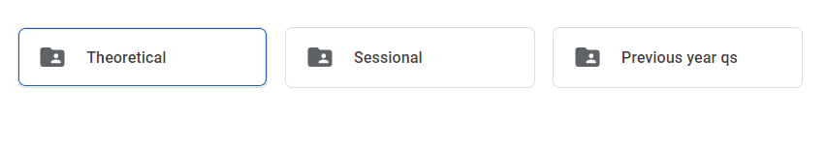
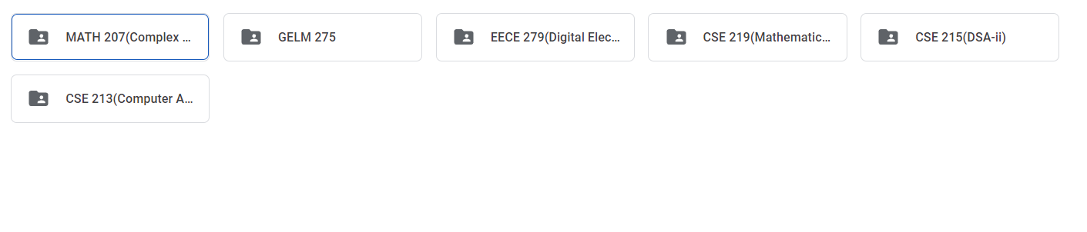
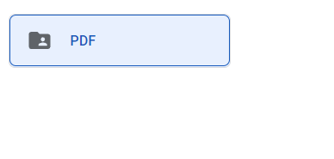
APP

Slide 6
Features
Search
Editor → Registration → Email /Student ID & Pass
→ Login → Email /Student ID & Pass

Slide 7
Thank You

